Slide 1

Floyd Burial 06/09/2020
Situation: Mr. George Floyd is scheduled to be entombed at Houston Memorial Gardens (2426 Cullen Blvd) on Tuesday 06/09/2020. Pearland PD, in conjunction with other agencies, have been tasked with providing security for the event and the surrounding area.

Slide 2
Floyd Burial 06/09/2020
  Mission:
  Pearland Cart team along with Texas DPS SRT and Border Patrol Tactical will provide security for Pearland Police Department, Dawson High School and the surrounding area with officers stationed for a quick response to rioting and looting.

Slide 3
Floyd Burial 06/09/2020
Execution:
  Pearland team will be responsible for responding to incidents outside of ECP 1 (PD Lobby). One team of TX DPS SRT will be with Pearland team.
  League City team will be responsible for responding to incidents outside of ECP 2 (Courts lobby). One team of TX DPS SRT will be with League City team.
  Alvin team will be responsible for responding to incidents outside of ECP 3 (side door of Courts lobby).
  Six sniper teams will be setup atop Pearland PD and Dawson High School. Three on top of Pearland PD and one in a Sky Box located in the back parking lot. Two more will be stationed on Dawson High School.

Slide 4
Floyd Burial 06/09/2020
Execution:
  Each team will be responsible for the security of their assigned side of the building. Should officers outside on the TCPs or on perimeter need support, the respective team will exit the building and assist those officers until the situation is under control and then return to the building.
  In the event of non-peaceful protesting, teams in conjunction with TXDPS SRG and Border Patrol Tac will take up positions around Pearland PD to prevent property loss or damage.
  Should arrests need to be made, Tac officers will secure the suspect and turn them over to on-duty PPD officers in the jail lobby for processing.
  All tac medics and team surgeon will be stationed at the PD to provide support to officers station at the PD.

Slide 5
Floyd Burial 06/09/2020
Execution:
  Chief of Police Spires expressed a desire to meet with funeral goers and pass out waters, Pearland Tac Officers will don patrol uniforms and escort Chief Spires in the crowd as this takes place. PSD officers will be following Chief Spires at a distance and act as an emergency extract team for Chief Spires if required.
  Private viewing for family only of Mr. Floyd will take place at 1100 at The Fountain of Praise church located at 13950 Hillcroft Ave. Houston, TX. Approximate transit time from church to Pearland is 16 mins.
  Lock down of the roadways will commence tentatively at 1200. All south bound traffic from McHard Rd and Cullen Pkwy and north Bound traffic from Freedom Dr and Cullen Pkwy. East and west bound traffic on McHard Rd at Country Place Blvd will be shut down tentatively at the same time.
  Mr. Floyd is expected to be escorted to Silver Lake Community Church located at 1865 Cullen Pkwy. Pearland, TX between 1345-1400 at which time Mr. Floyd will be removed from the vehicle escort and placed into a horse and carriage. Mr. Floyd is then expected to transit from Silver Lake Church to his final resting place at Houston Memorial Gardens located approximately one mile south on Cullen Pkwy.

Slide 6
Floyd Burial 06/09/2020
Execution:
  Mr. Floyd will be escorted by our bike patrol while in the carriage.
  As the funeral precession crosses each of the TCP’s, that respective TCP will shut down all north and south bound traffic.
  Special Assignments:
    PSD: Ofc. Tauss, Ofc Gassen, Ofc. Layton, Ofc Marin
    Sniper team 1: Ofc. Hererra, Ofc. Fletcher
    Sniper team 2: Ofc. Kiefer, Ofc. Crumpler
    Sniper team 3: TX DPS SRT
    Sniper team 4: TX DPS SRT
    Sniper team 5: BorTac
    Sniper team 6: BorTac
    Sniper team 7 (Reserve): Ofc. Jackson, Ofc. Comer

Slide 7
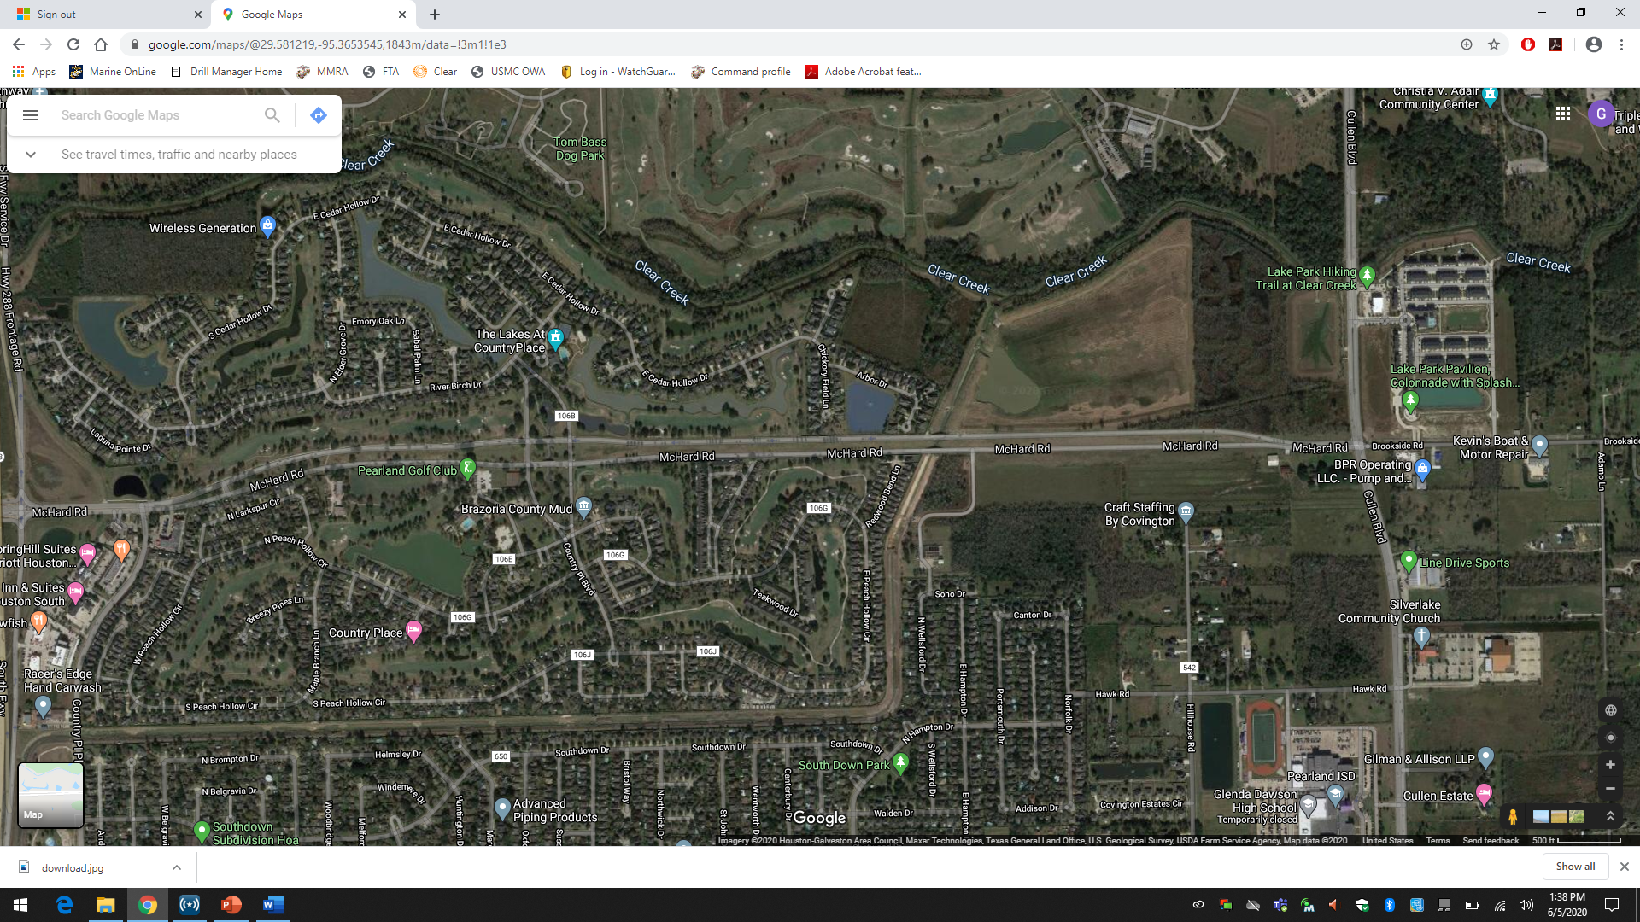
Floyd Burial 06/09/2020
TCP 2
10 person
TCP 4
4 person
TCP 1
10 person
TCP 3
10 person
2 dump trucks
QRF 1
10 Person

Slide 8
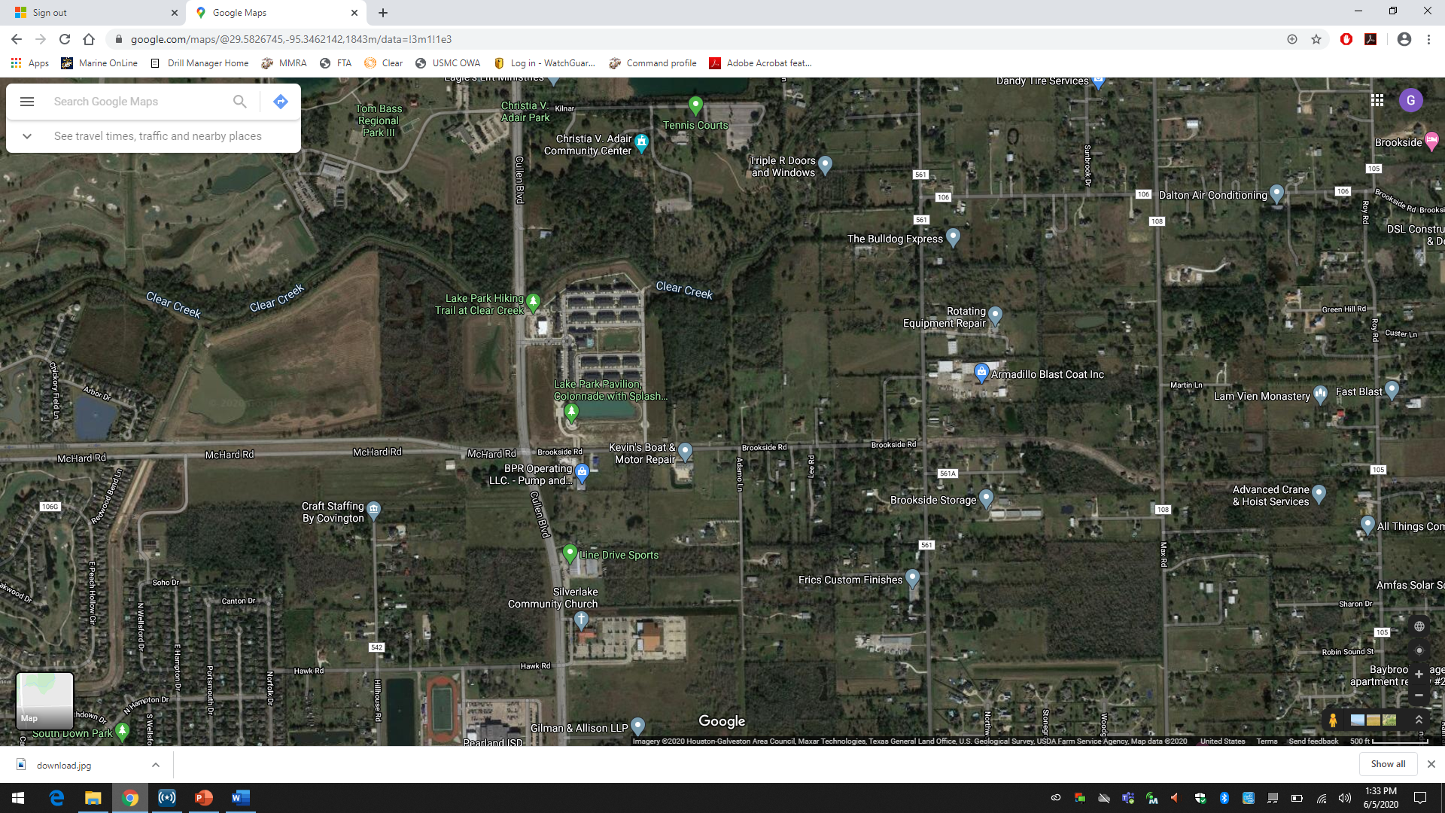
Floyd Burial 06/09/2020
TCP 2
10 person
TCP 4
4 person
TCP 5
4 person
TCP 3
2 dump trucks
10 Person
Church

Slide 9
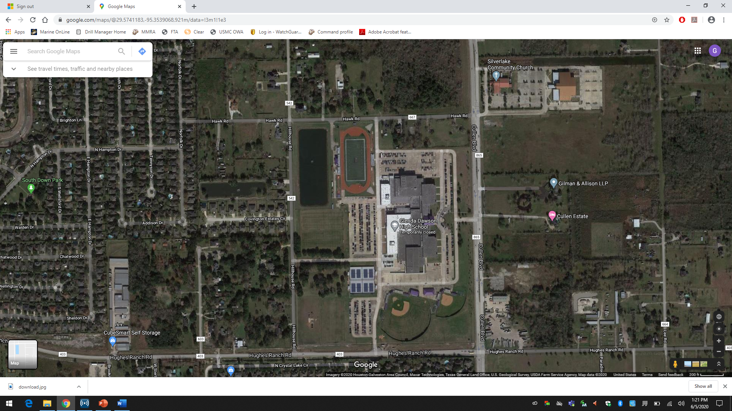
Floyd Burial 06/09/2020
Church
Body moved
to carriage
TCP 7
4 person
TCP 6
10 person
Dawson Command
National Guard
BorTac
TX DPS
2 LMTV
TCP 8
4 person
TCP 11
4 person
TCP 9
4 person
TCP 10
10 Person

Slide 10
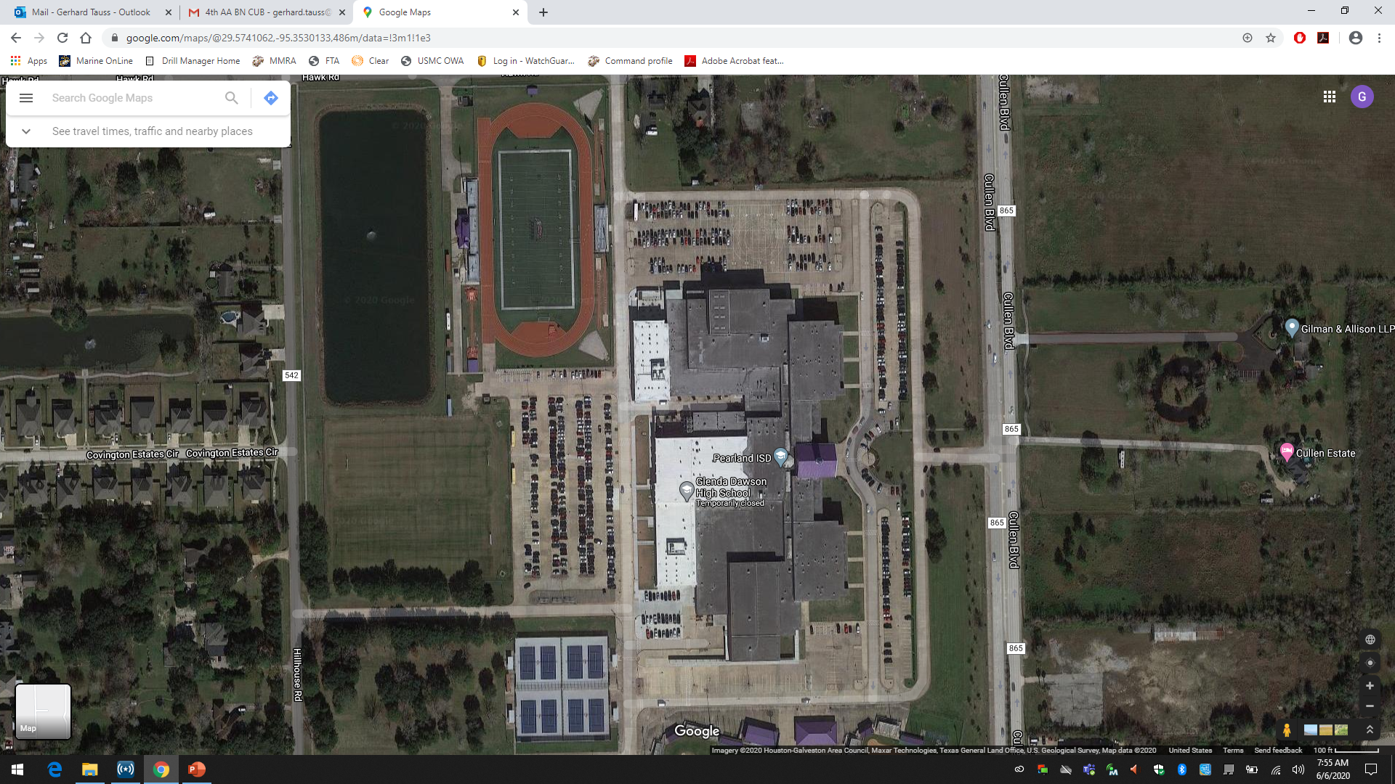
Floyd Burial 06/09/2020
“Overwatch 5”
BorTac
“Overwatch 6”
BorTac

Slide 11
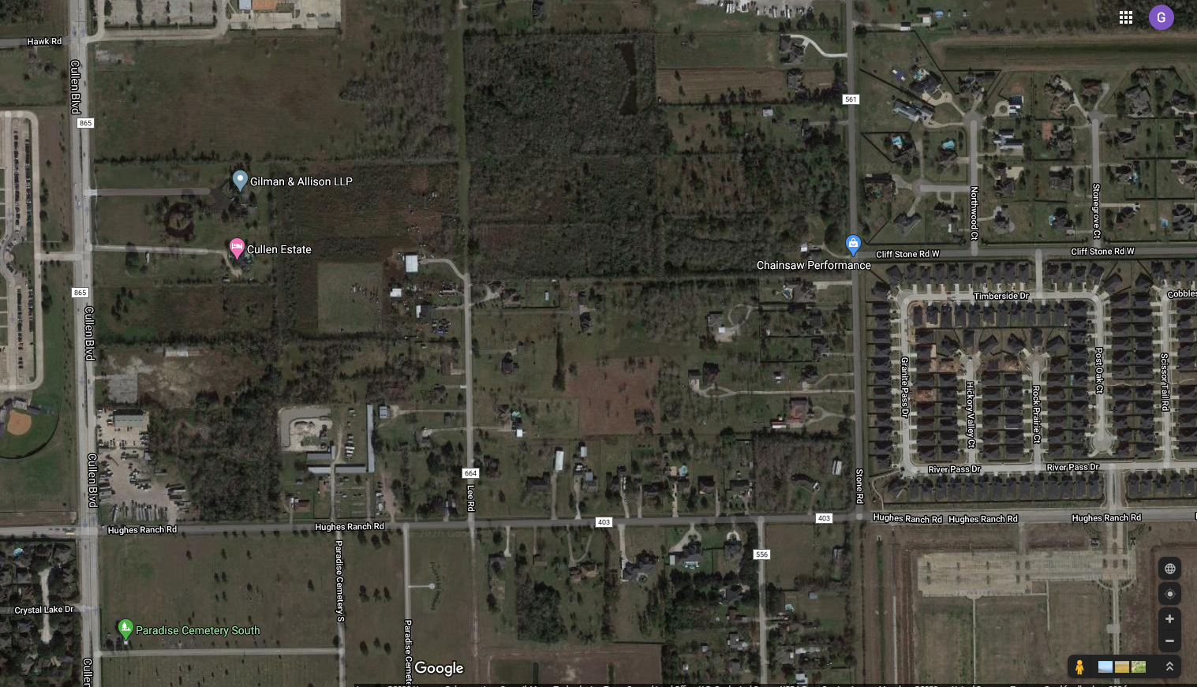
Floyd Burial 06/09/2020
Church
TCP 10
10 person
TCP 12
4 person
TCP 11
4 People
QRF 2
10 person

Slide 12
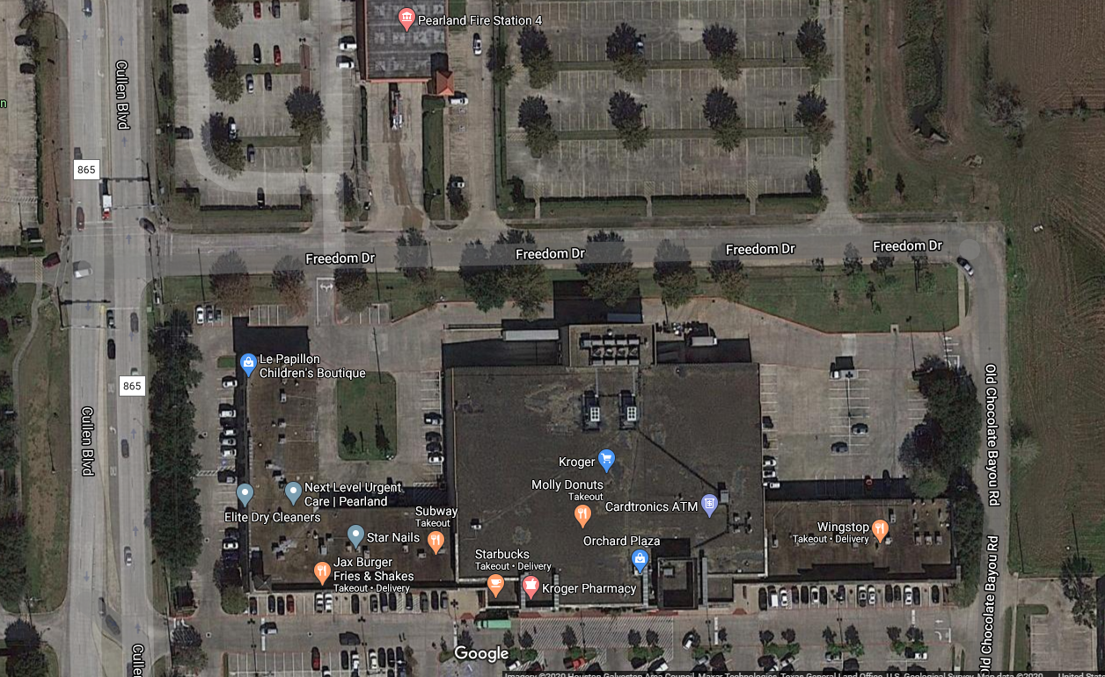
Floyd Burial 06/09/2020
TCP 13
3 dump trucks
2 LMTV
10 Person
TCP 15
4 person
QRF 3
10 person
TCP 14
2 LMTV 10 Person

Slide 13
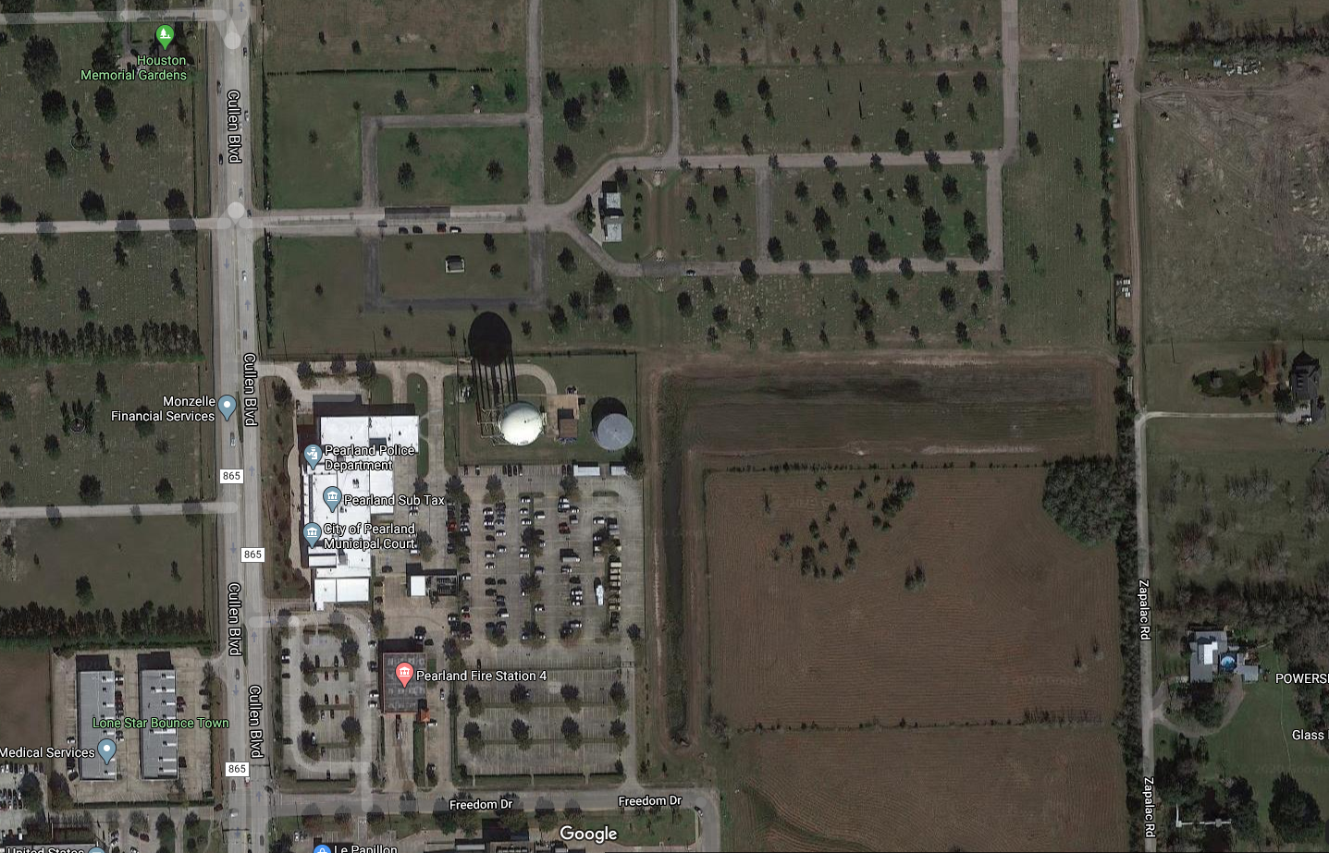
Floyd Burial 06/09/2020
TCP 17
2 person

Slide 14
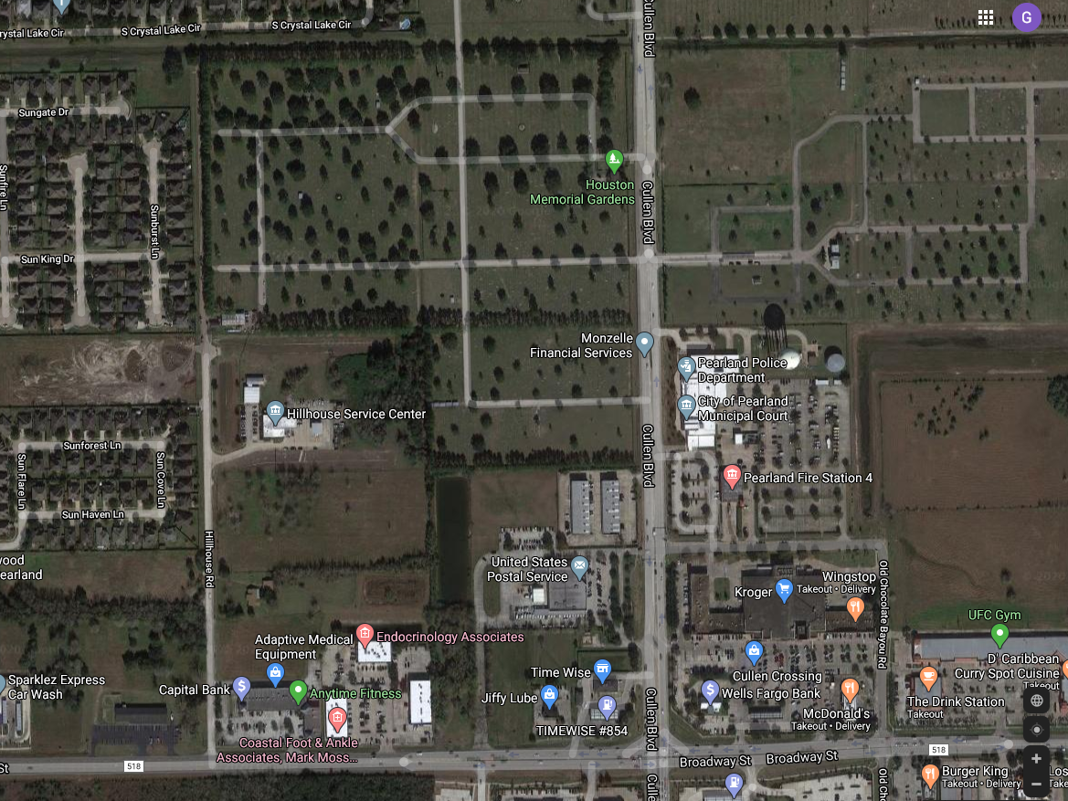
Floyd Burial 06/09/2020
TCP 16
2 person

Slide 15
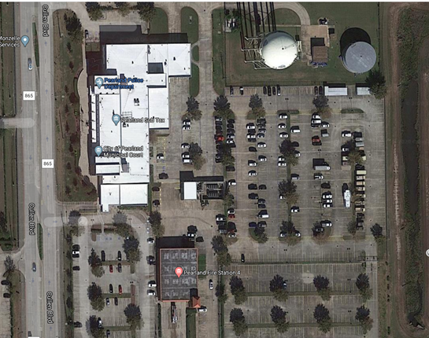
Floyd Burial 06/09/2020
ECP 1
ECP 2
ECP 3

Slide 16
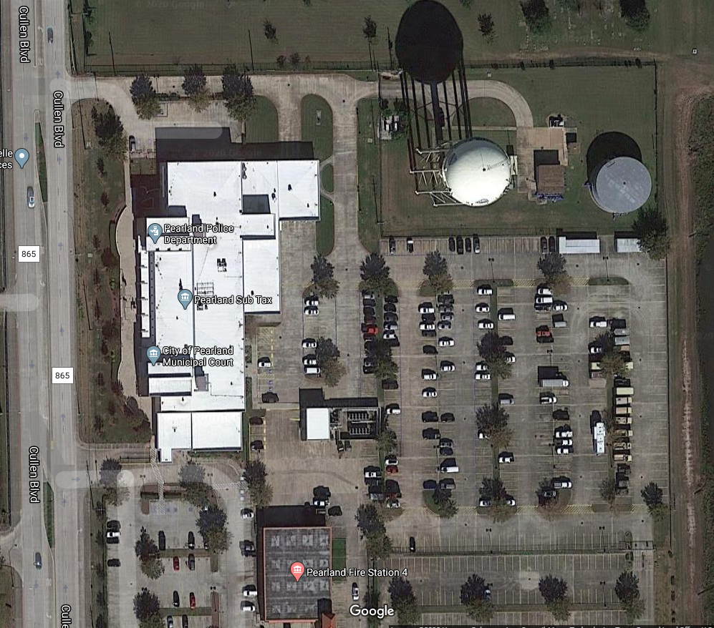
Floyd Burial 06/09/2020
Pearland Team TAC 1
LC Team
TAC 2
Alvin Team
TAC 3

Slide 17
Floyd Burial 06/09/2020
“Overwatch 1”
“Overwatch 2”
“Overwatch 4”
“Overwatch 3”

Slide 18
Floyd Burial 06/09/2020
4 vehicle roving team
8 person PD/FD
Gate 1
2 person
Jail “P2”
2 person
Perimeter “P1”
10 person
4 person
Roving “P3”
Gate 3
2 Person
Gate 2
2 person

Slide 19
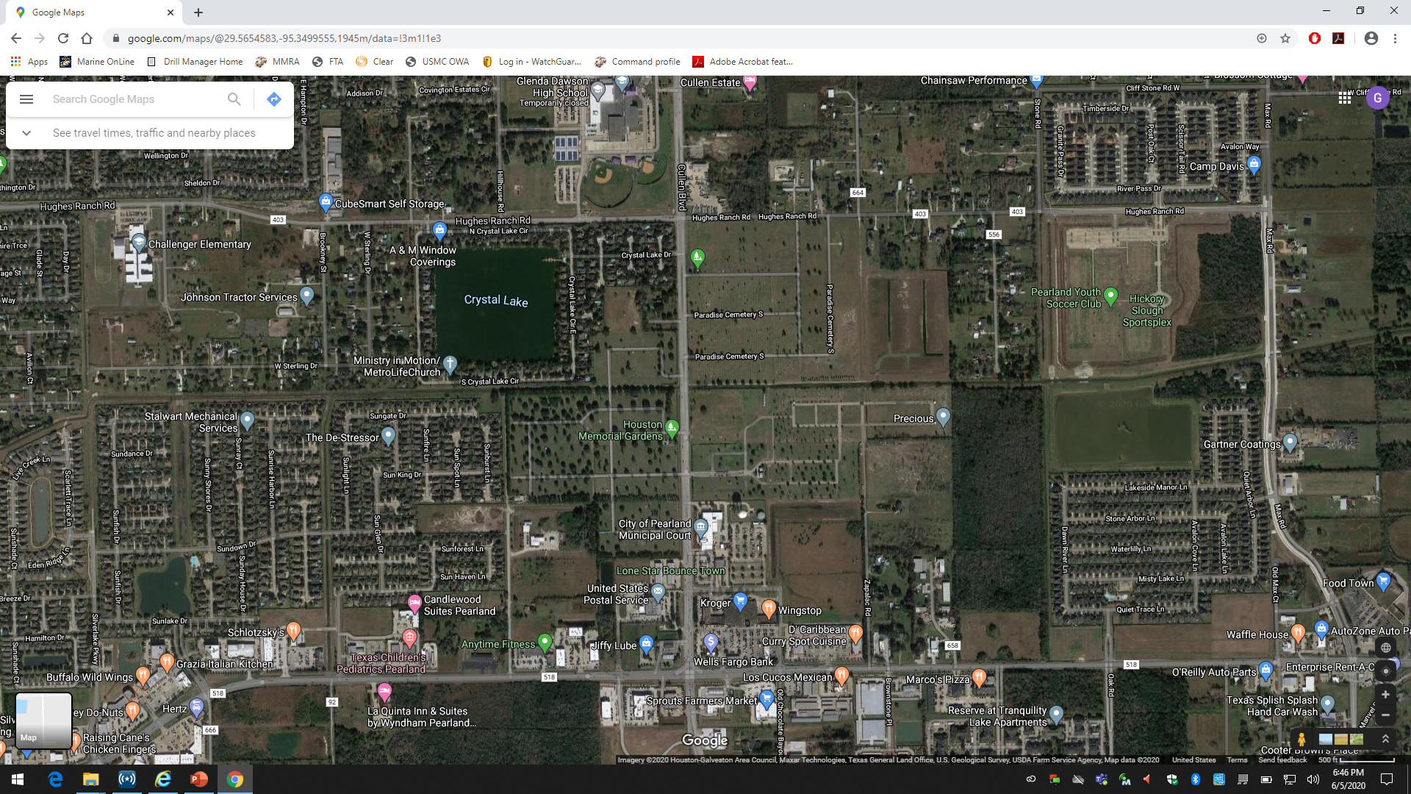
Floyd Burial 06/09/2020
Bike Patrol
along Cullen
9 person
2 UCs
In crowd

Slide 20
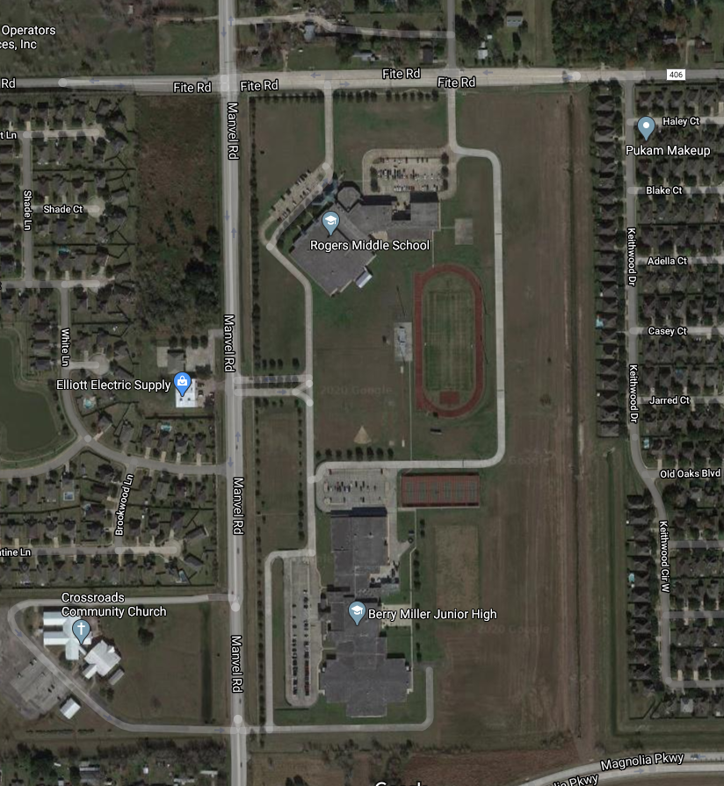
Floyd Burial 06/09/2020
Fall back EOC/
Resource staging

Slide 21
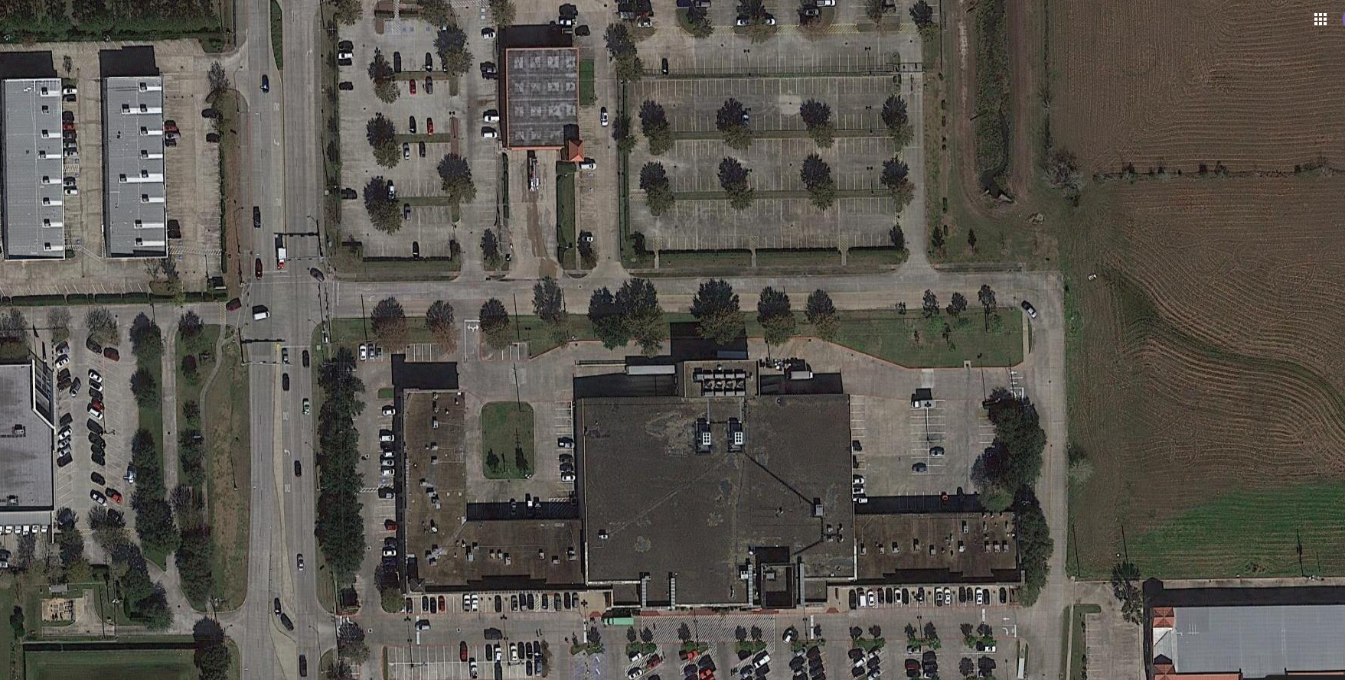
Floyd Burial 06/09/2020
LZ
Secondary South LZ
Primary South LZ
LZ

Slide 22
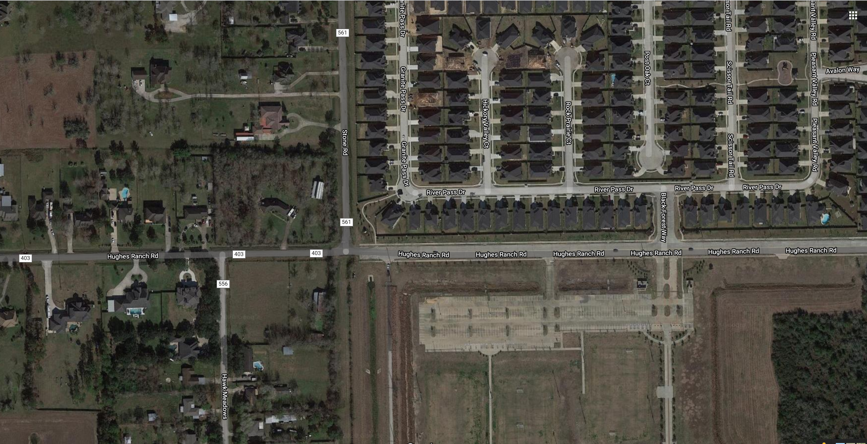
Floyd Burial 06/09/2020
Secondary North LZ
LZ

Slide 23
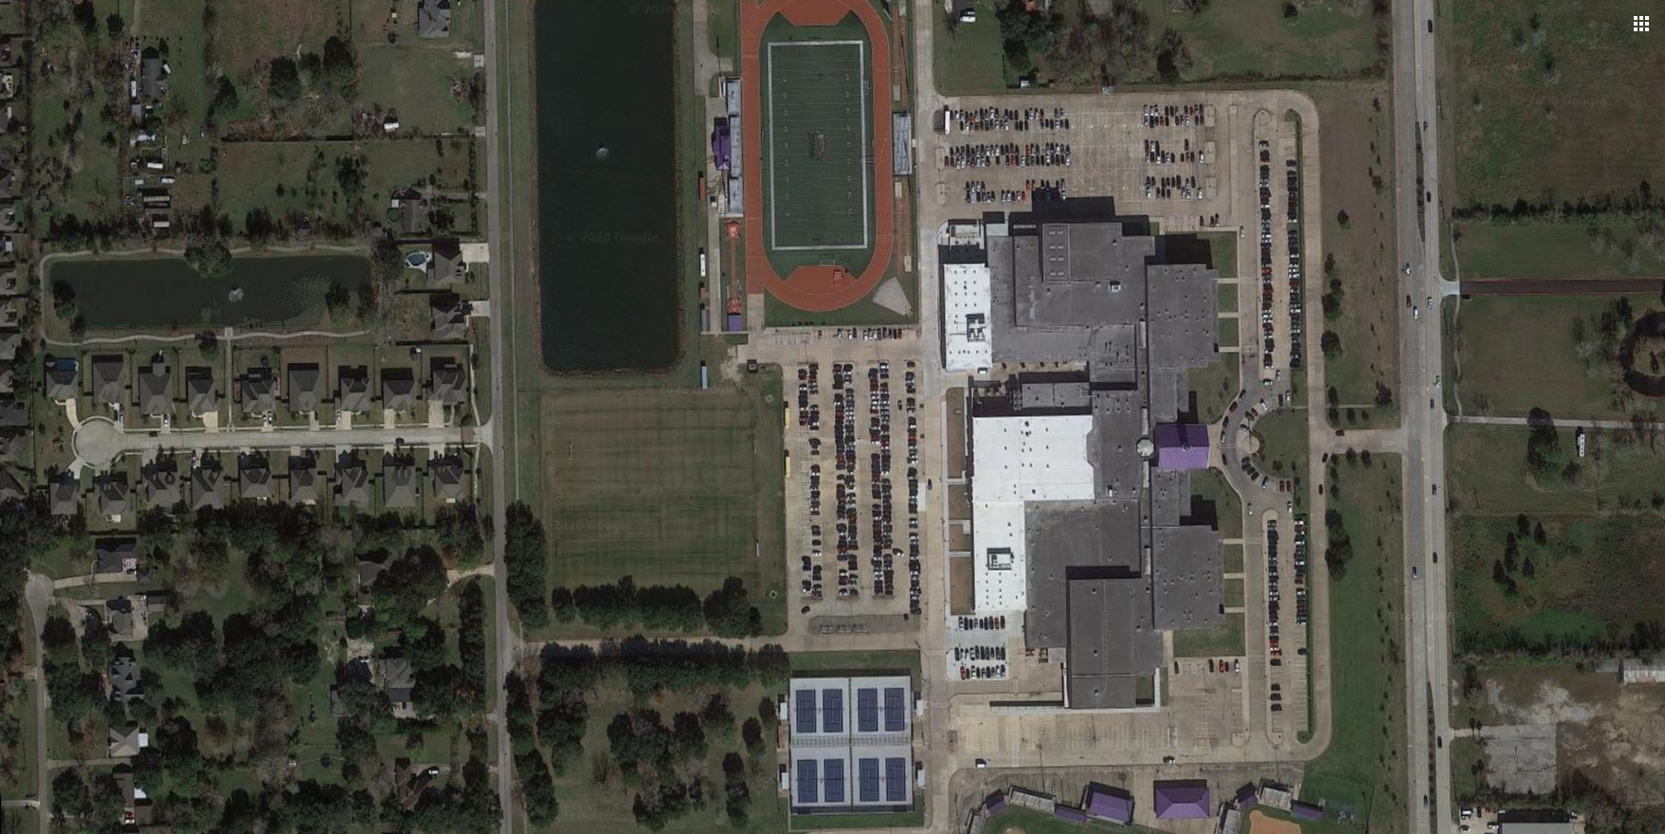
Floyd Burial 06/09/2020
Primary North LZ
LZ

Slide 24
Floyd Burial 06/09/2020
Admin/Logistics
  Admin:
    Show time for key leaders will be 0830 and operators at 0900.
    PPD: 57 personal
    CART: 32 personal
    TX DPS SRT: 20 personal
    BorTac: 66 Personal
    National Guard: 100 with 800 in reserve
    TX DPS: 200 personal
  Logistics:
    Uniform of the day will be SWAT greens or multicams for medics.
    Uniform of the day for snipers will be blue PD polo and Khaki pants.
    PSD team will bring standard patrol uniform.
    Teams will have all assigned Tac gear.
    Sniper will have their assigned long gun.
    Teams should ensure they have adequate water and food while in position.

Slide 25
Floyd Burial 06/09/2020
Command/Signal
  Command:
    Commander: Capt. Nichols, Lt. Woitena, Sgt. Kingham
    Tact Commander: Lt. Dunham, Lt. Antley, Sgt Shoemake
    TL: Ofc. Tauss, Ofc Palomo, Sgt. Massey, Ofc. Bradshaw, Ofc. McDonald
    Sniper TL: Ofc. Herrera
    Tac Medic TL: Capt. Ward, Dr. Santos
  Signal:
    Primary radio channel for TAC/SRT/SRG: YICS 15
    Secondary radio channel for TAC/SRT/SRG: YICS 14
    Perimeter team: YICS 3
    TCP’s and QRF’s: YICS 8/HCMA 4
    Dawson Command (DPS, BorTac, SRO’s): YICS 4
    Air operations: Zone 80 Ch10 (8TAC94D)
    Fire Department: Fire Tac 3

Slide 26
Floyd Burial 06/09/2020
Immediate Action plan:
  Active Attack:
    Sniper teams will visually verify the threat and engage threat if it can be done safely. In the event it cannot be done safely, teams will continue and track suspect while passing on suspect information to officers on the ground to intercept any active attack threats.
    Med Evac:
    Once injured personnel is in a controlled and secured environment/location, they will then be transported to the CCP/RP for evaluation (Command post). Pearland EMS will coordinate all Med Evacs.
  Injured personnel under hostile fire:
    If possible and when safe will be moved to the nearest cover and concealment point for treatment. SRG teams will make efforts to recover the downed officer.

Slide 27
Floyd Burial 06/09/2020
Immediate Action plan:
  Violent protesting and damage to personal property:
    In the event of violent protesting, Officers will exit the building and form a perimeter around the Police Department to prevent any damage to the PD. SRG teams will form a riot line to further control violent protesting. Pearland Team will act as an arrest team as needed.
    Officer Extraction:
    SRG/CART will push out from the building and establish a secure line and move to the officer(s) in distress. A secure cordon will be established around the officer(s) and will be brought back to a secure facility.
  Explosive device (Land Slide):
    Evacuate the area immediately. Secure the area and call in the bomb squad.
  Patrol needs assistance:
    BorTac will respond from Dawson High School to the needed location.

Slide 28
Floyd Burial 06/09/2020
Immediate Action plan:
  Rules of Engagement:
    Level I: Large, peacefully assembling crowds in the front of PD.
      Officers in soft uniforms, no escalated presence.
    Level II: Verbal Aggressive language and empty water bottles (nuisance).
      DPS troopers on perimeter of building, BorTac geared up ready to deploy
    Level III: Full water bottles and bricks (weapons/weapons of opportunity)
      Field force deployment (BorTac) in conjunction with arrest teams (CART).
      Less lethal/gas munitions
      National Guard ready posture as last line of defense.
    Level IV:
      Deadly force is authorized anytime under Ch 9 Texas Penal Code (Ch 9.31/Ch 9.32).

Slide 29
ANY QUESTIONS?

